Slide 1
Course Summary
Signal Propagation and Channel Models
Modulation and Performance Metrics
Impact of Channel on Performance
Fundamental Capacity Limits
Flat Fading Mitigation
  Diversity
  Adaptive Modulation
ISI Mitigation
  Equalization
  Multicarrier Modulation
  Spread Spectrum

Slide 2


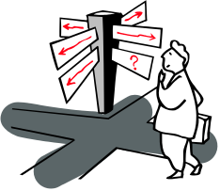

Future Wireless Networks
Ubiquitous Communication Among People and Devices
Wireless Internet access
Nth generation Cellular
Wireless Ad Hoc Networks
Sensor Networks
Wireless Entertainment
Smart Homes/Spaces
Automated Highways
All this and more…
Hard Delay/Energy Constraints
Hard Rate Requirements

Slide 3
Design Challenges
Wireless channels are a difficult and capacity-limited broadcast communications medium
Traffic patterns, user locations, and network conditions are constantly changing
Applications are heterogeneous with hard constraints that must be met by the network
Energy, delay, and rate constraints change design principles across all layers of the protocol stack

Slide 4

Signal Propagation
Path Loss
Shadowing
Multipath
d
P_{r}/P_{t}
d=vt

Slide 5

Statistical Multipath Model
Random # of multipath components, each with varying amplitude, phase, doppler, and delay
Narrowband channel
  Signal amplitude varies randomly (complex Gaussian).
  2nd order statistics (Bessel function), Fade duration, etc.
Wideband channel
  Characterized by channel scattering function (B_{c},B_{d})

Slide 6
Capacity of Flat Fading Channels
Three cases
  Fading statistics known
  Fade value known at receiver
  Fade value known at receiver and transmitter
Optimal Adaptation
  Vary rate and power relative to channel
  Optimal power adaptation is water-filling
  Exceeds AWGN channel capacity at low SNRs
  Suboptimal techniques come close to capacity

Slide 7
Modulation Considerations
Want high rates, high spectral efficiency, high power efficiency, robust to channel, cheap.
Linear Modulation (MPAM,MPSK,MQAM)
  Information encoded in amplitude/phase
  More spectrally efficient than nonlinear
  Easier to adapt.
  Issues: differential encoding, pulse shaping, bit mapping.
Nonlinear modulation (FSK)
  Information encoded in frequency
  More robust to channel and amplifier nonlinearities

Slide 8
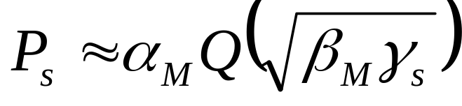
Linear Modulation in AWGN
ML detection induces decision regions
  Example: 8PSK
P_{s} depends on
  # of nearest neighbors
  Minimum distance d_{min} (depends on γ_{s})
  Approximate expression
d_{min}

Slide 9
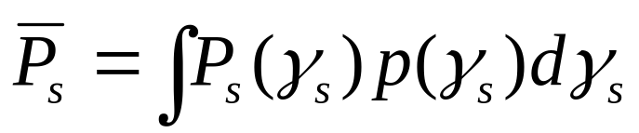
Linear Modulation in Fading
In fading γ_{s} and therefore P_{s} random
Metrics: outage, average P_{s} , combined outage and average.
T_{s}
P_{s}
Outage
P_{s(target)}
P_{s}
T_{s}

Slide 10
Moment Generating
Function Approach
Simplifies average P_{s} calculation
Uses alternate Q function representation
P_{s} reduces to MGF of γ_{s} distribution
Closed form or simple numerical calculation for general fading distributions
Fading greatly increases average P_{s} .

Slide 11
Doppler Effects
High doppler causes channel phase to decorrelate between symbols
Leads to an irreducible error floor for differential modulation
  Increasing power does not reduce error
Error floor depends on B_{d}T_{s}

Slide 12
ISI Effects
Delay spread exceeding a symbol time causes ISI (self interference).
ISI leads to irreducible error floor
  Increasing signal power increases ISI power
ISI requires that T_{s}>>T_{m} (R_{s}<<B_{c})
0
Tm

Slide 13
Variable-Rate Variable-Power MQAM
log₂ M(γ) Bits
One of the
M(γ) Points
To Channel
Point
Selector
M(γ)-QAM
Modulator
Power: S(γ)
Uncoded
Data Bits
Delay
γ(t)
γ(t)
BSPK
4-QAM
16-QAM
Goal: Optimize S(γ) and M(γ) to maximize EM(γ)

Slide 14

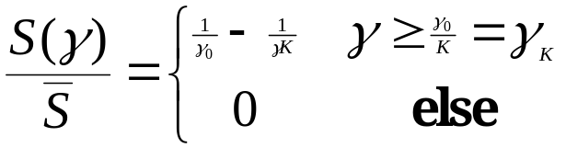

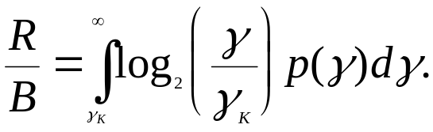
Optimal Adaptive Scheme
Power Water-Filling
Spectral Efficiency
γ_{k}
γ
γ
Equals Shannon capacity with an effective power loss of K.

Slide 15
Practical Constraints
Constellation restriction
Constant power restriction
Constellation updates.
Estimation error.
Estimation delay.

Slide 16
Diversity
Send bits over independent fading paths
  Combine paths to mitigate fading effects.
Independent fading paths
  Space, time, frequency, polarization diversity.
Combining techniques
  Selection combining (SC)
  Equal gain combining (EGC)
  Maximal ratio combining (MRC)

Slide 17
Diversity Performance
Maximal Ratio Combining (MRC)
  Optimal technique (maximizes output SNR)
  Combiner SNR is the sum of the branch SNRs.
  Distribution of SNR hard to obtain.
  Can use MGF approach for simplified analysis.
  Exhibits 10-40 dB gains in Rayleigh fading.
Selection Combining (SC)
  Combiner SNR is the maximum of the branch SNRs.
  Diminishing returns with # of antennas.
  CDF easy to obtain, pdf found by differentiating.
  Can get up to about 20 dB of gain.

Slide 18
Multiple Input Multiple
Output (MIMO)Systems
MIMO systems have multiple (M) transmit and receiver antennas
With perfect channel estimates at TX and RX, decomposes to M indep. channels
  M-fold capacity increase over SISO system
  Demodulation complexity reduction
Beamforming alternative:
  Send same symbol on each antenna (diversity gain)
  Diversity versus capacity (multiplexing) tradeoff

Slide 19








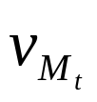
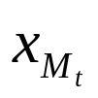
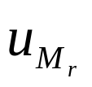
Beamforming
Scalar codes with transmit precoding
y=u^{H}Hvx+u^{H}n
Transforms system into a SISO system with diversity.
  Array and diversity gain
  Greatly simplifies encoding and decoding.
  Channel indicates the best direction to beamform
  Need “sufficient” knowledge for optimality of beamforming
Precoding transmits more than 1 and less than R_{H} streams
  Transmits along some number of dominant singular values

Slide 20
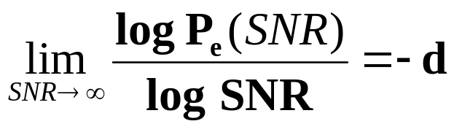
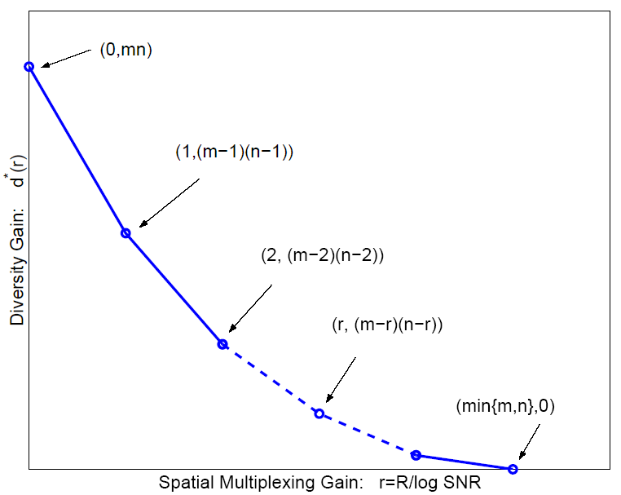
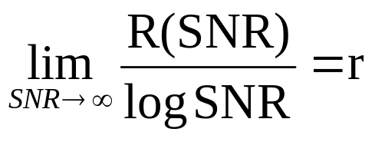
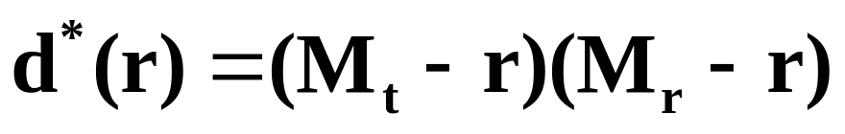
Diversity vs. Multiplexing
Use antennas for multiplexing or diversity
Diversity/Multiplexing tradeoffs (Zheng/Tse)
Error Prone
Low P_{e}

Slide 21



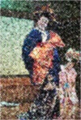

How should antennas be used?
Use antennas for multiplexing:
Use antennas for diversity
High-Rate
Quantizer
ST Code
High Rate
Decoder
Error Prone
Low-Rate
Quantizer
ST Code
High
Diversity
Decoder
Low P_{e}
Depends on end-to-end metric: Solve by optimizing app. metric

Slide 22
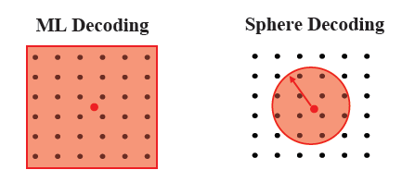
MIMO System Design Issues
Low Complexity Receivers
  ML receivers exponentially complex # of streams and constellation size
  Sphere decoding, only considers possibilities within a sphere of received symbol.
Space-time coding:
  Map symbols to both space and time via space-time block and convolutional codes.
  For OFDM systems, codes are also mapped over frequency tones.
Adaptive techniques:
  MIMO systems adapt the use of transmit/receive antennas in addition to adapting modulation and coding.
  Limited feedback: With limited capacity on the feedback path, techniques rely on partial CSI

Slide 23
Digital Equalizers
n(t)
d(t)=Σd_{n}p(t-nT)
^
y_{n}
d_{n}
c(t)
+
g*(-t)
H_{eq}(z)
Equalizer mitigates ISI
  Typically implemented as FIR filter.
Criterion for coefficient choice
  Minimize P_{b} (Hard to solve for)
  Eliminate ISI (Zero forcing, enhances noise)
  Minimize MSE (balances noise increase with ISI removal)
Channel must be learned through training and tracked during data transmission.

Slide 24
Multicarrier Modulation
Divides bit stream into N substreams
Modulates substream with bandwidth B/N
  Separate subcarriers
  B/N<B_{c} flat fading (no ISI)
Can overlap substreams
  More spectrally efficient
  Substreams separated in receiver
  Min. carrier separation of 1/T_{N} (substream symbol time)
R/N bps
QAM
Modulator
x
R bps
Serial
To
Parallel
Converter
cos(2πf₀t)
Σ
R/N bps
QAM
Modulator
x
cos(2πf_{N}t)

Slide 25
FFT Implementation of OFDM
Efficient IFFT structure at transmitter
  Reverse structure (with FFT) at receiver
  Cyclic prefix makes linear convolution circular, so there is no interference between input blocks
Issues
  Timing/frequency offset impacts subcarrier orthogonality
  Adding signals creates large signal peaks (large PAPR)
  Fading across subcarriers impacts performance
X₀
x₀
R bps
Serial
To
Parallel
Converter
Add cyclic
prefix and
Parallel
To Serial
Convert
QAM
Modulator
D/A
x
IFFT
X_{N-1}
x_{N-1}
cos(2πf_{c}t)

Slide 26
Fading Across Subcarriers
Compensation techniques
  Frequency equalization (noise enhancement)
  Precoding (channel inversion)
  Coding across subcarriers
  Adaptive loading (power and rate)
Practical Issues for OFDM
  Peak-to-average power ration
  System imperfections

Slide 27
Direct Sequence
Spread Spectrum
Bit sequence modulated by chip sequence
Spreads bandwidth by large factor (K)
Despread by multiplying by s_{c}(t) again (s_{c}(t)=1)
Mitigates ISI and narrowband interference
  ISI mitigation a function of code autocorrelation
Must synchronize to incoming signal
S(f)
s(t)
s_{c}(t)
S_{c}(f)
S(f)*S_{c}(f)
1/T_{b}
T_{c}
T_{b}=KT_{c}
1/T_{c}
2

Slide 28
ISI and Interference Rejection
Narrowband Interference Rejection (1/K)
Multipath Rejection (Autocorrelation ρ(τ))
S(f)
I(f)
S(f)
S(f)*S_{c}(f)
I(f)*S_{c}(f)
Info. Signal
Receiver Input
Despread Signal
S(f)
S(f)*S_{c}(f)[αδ(t)+β(t-τ)]
αS(f)
βρS’(f)
Info. Signal
Receiver Input
Despread Signal

Slide 29
Pseudorandom Sequences
Autocorrelation determines ISI rejection
  Ideally equals delta function
Maximal Linear Codes
  No DC component
  Large period (2^{n}-1)T_{c}
  Linear autocorrelation
  Recorrelates every period
  Short code for acquisition, longer for transmission
  In SS receiver, autocorrelation taken over T_{b}
  Poor cross correlation (bad for MAC)
1
-1
2^{n}-1
-T_{c}
T_{c}

Slide 30
Synchronization
Adjusts delay of s_{c}(t-τ) to hit peak value of autocorrelation.
  Typically synchronize to LOS component
Complicated by noise, interference, and MP
Synchronization offset of Δt leads to signal attenuation by ρ(Δt)
1
ρ(Δt)
Δt
-1
2^{n}-1
-T_{c}
T_{c}

Slide 31
RAKE Receiver
Multibranch receiver
  Branches synchronized to different MP components
These components can be coherently combined
  Use SC, MRC, or EGC
x
Demod
y(t)
s_{c}(t)
^
d_{k}
x
Diversity
Combiner
Demod
s_{c}(t-iT_{c})
x
Demod
s_{c}(t-NT_{c})

Slide 32
Megathemes of EE359
The wireless vision poses great technical challenges
The wireless channel greatly impedes performance
  Low fundamental capacity.
  Channel is randomly time-varying.
  ISI must be compensated for.
  Hard to provide performance guarantees (needed for multimedia).
We can compensate for flat fading using diversity or adapting.
MIMO channels promise a great capacity increase.
A plethora of ISI compensation techniques exist
  Various tradeoffs in performance, complexity, and implementation.
  OFDM and spread spectrum are the dominent techniques

